Slide 1

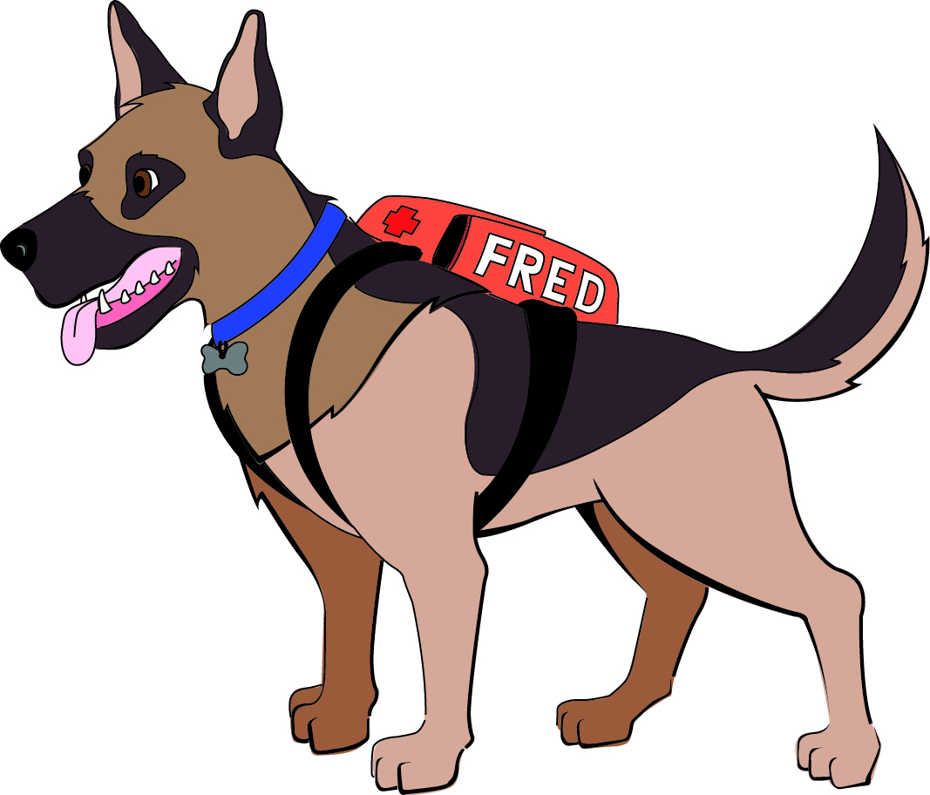


Prepardy
Emergency Preparedness Game
First Edition
Ages 6+

Slide 2

Prepardy Rules
Answers must be in the form of a question
Points for partially correct answers are awarded at the teacher’s discretion
Notes:
Briefly discuss the rules of the game as they appear on the screen.

Slide 3
Make a
Plan
Make a
Kit
Stay
Informed
Resources
Fred
$100
$100
$100
$100
$100
$200
$200
$200
$200
$200
$300
$300
$300
$300
$300
$400
$400
$400
$400
$400
$500
$500
$500
$500
$500
Final Prepardy

Slide 4
Make a Plan - $100
In an emergency, you should call this number.
What is 911?
Back

Slide 5

Make a Plan - $200
When riding in the car we should always wear our ______.
What is Seatbelt?
Back

Slide 6
Make a Plan - $300
In case of a _____, you should meet with your family outside of your home.
What is Fire?
Back

Slide 7
Make a Plan - $400
In case of a _______, your family should take shelter in a basement or safe room.
What is Tornado?
Back

Slide 8
Make a Plan - $500
This should have its batteries changed twice a year at the same time clocks are set.
What is a Smoke Detector?
Back

Slide 9
Make a Kit - $100
This item can help you see if the power goes out.
What is a Flashlight?
Back

Slide 10
Make a Kit - $200
Having this in your kit will help you if you get thirsty.
What is Water?
Back

Slide 11
Make a Kit - $300
These items can give us something to do or play with while in the shelter.
What are Games or Toys?
Back

Slide 12
DAILY DOUBLE

Slide 13
Daily Double - $800
Having some ______ in the kit will be nice in case you get hungry.
What is Food or Snacks?
Back

Slide 14
Make a Kit - $500
Fred has one in his kit because it is hard for him to drink water from a bottle.
What is a Water Dish or Bowl?
Back

Slide 15
Stay Informed - $100
Mom and Dad watch this to know if it will be nice outside or if storms may come.
What is the Weather?
Back

Slide 16
Stay Informed - $200
This person can help you be ready for emergencies at home.
Who is Mom, Dad, Brother, Sister or Family Member?
Back

Slide 17
Stay Informed - $300
A person in the classroom who can tell you what’s going on and what you should do to be safe in the school.
Who is a Teacher?
Back

Slide 18
Stay Informed - $400
Something that will sound an alarm in case of a fire.
What is a Smoke Detector?
Back

Slide 19
Stay Informed - $500
This outside alarm let’s us know if bad weather is coming our way.
What is a Tornado Siren?
Back

Slide 20
Resources - $100
A person at home who can help us Make a Kit, Make a Plan, and Stay Informed.
Who is a Parent or Family Member?
Back

Slide 21
Resources - $200
People in our community that can help us get ready for emergencies.
Who are Police, Firefighters, Emergency Medical Personnel, and Emergency Management?
Back

Slide 22
Resources - $300
A furry friend who wants our family and pets to be ready for all emergencies.
Who is Fred the Preparedness Dog?
Back

Slide 23
Resources - $400
Someone who we can have as an Emergency Contact.
Who are Grandparents, Doctors, Neighbors, Family Members?
Back

Slide 24
Resources - $500
This can help Mom and Dad or others take care of us in case we get hurt.
What is a
First Aid Kit?
Back

Slide 25
Fred - $100
Fred is this kind of dog.
What is a German Shepherd?
Back

Slide 26
Fred - $200
A Frisbee.
What is Fred’s favorite toy?
Back

Slide 27
Fred - $300
The color of Fred’s fur.
What is Brown?
Back

Slide 28
Fred - $400
Fred’s favorite snack.
What is Popcorn?
Back

Slide 29
Fred - $500
How much Fred weighs.
What is 100 pounds?
Back

Slide 30
FINAL PREPARDY
Pet Emergencies
?

Slide 31
Dogs like Fred are able to smell a lot better than people can. To give them something with a familiar smell and to cuddle with in the shelter, they should have a _____.
What is a Blanket?
Back

